Slide 1
CS 395T: Communicative and Grounded AI Agents
Fall 2025

Slide 2
Today: Introductions
Who am I?
Intro and Overview
Goals
Topics
Presentation
Project
Participation
How to read and present papers
How to find papers
Logistics

Slide 3
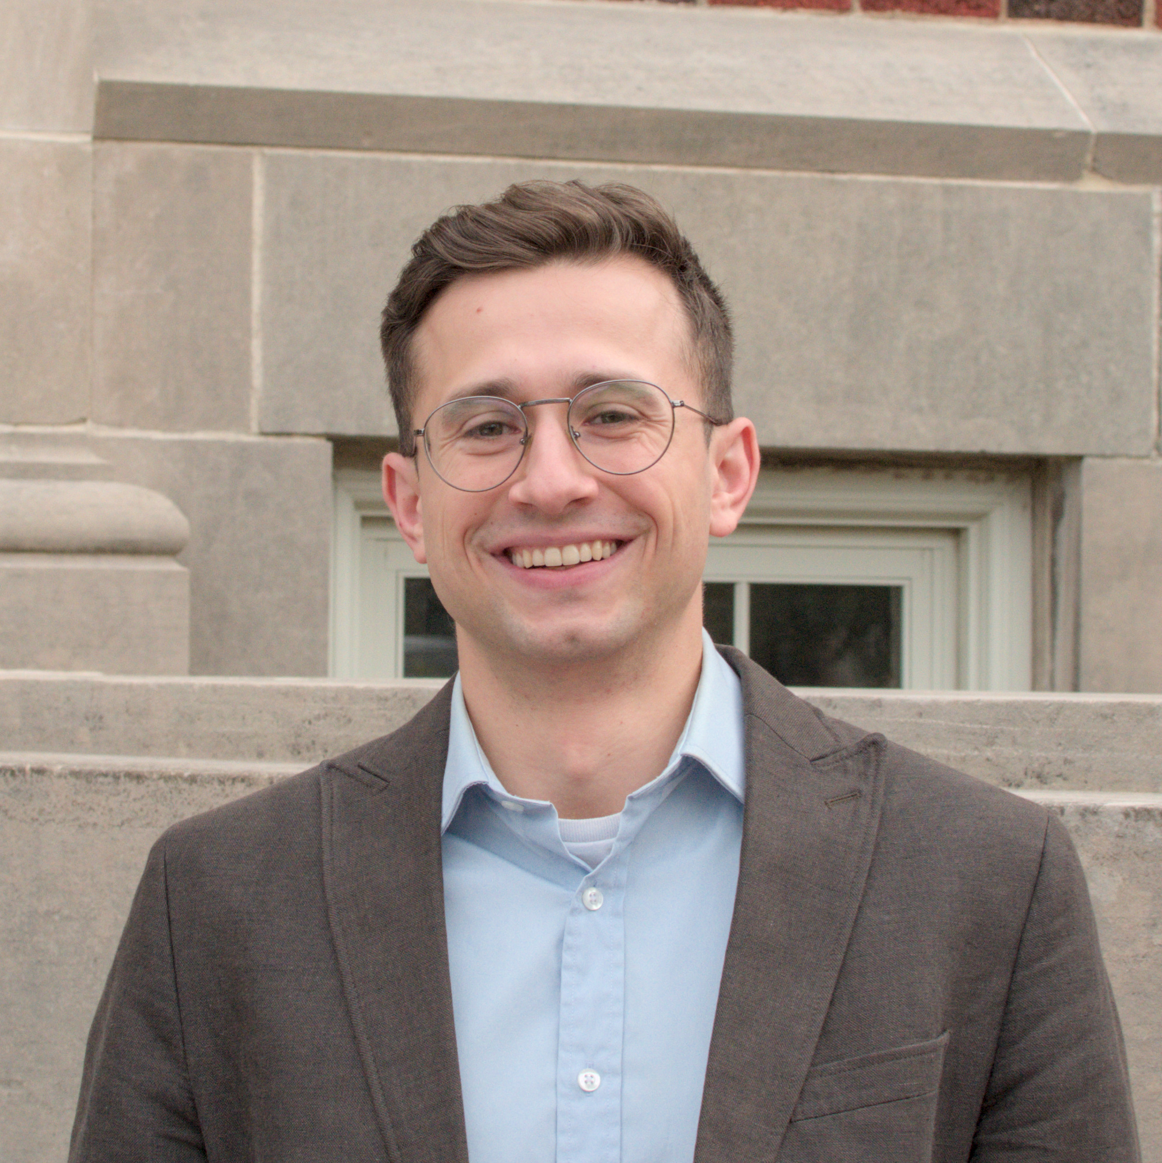
Who am I?
Assistant Professor in Computer Science
Developing AI agents that intelligently communicate and collaborate with people and each other
Multi-agent communication/collaboration (debate, distillation, pragmatics, persuasion)
Grounding (vision-language, text-to-action, text-to-code)
Handling uncertainty, ambiguity, and underspecification
CS and CogSci
Especially linguistics

Slide 4
Overview
Course goals:
Understanding the fundamental questions and challenges in developing agents.
An ability to find, assess, and read cutting-edge research.
An ability to situate research in historical context.
Brainstorming, developing, and executing an exciting course project in line with course topics.

Slide 5
Overview
Evaluation
Presentation
Project
Participation

Slide 6
Topics covered/Schedule
Weeks | Topic
1 | Intro + LLM background
2-3 | LLMs for Action (semantic parsing, tool use, program induction/skill learning, optimization, uncertainty and calibration)
4-5 | Multi-agent (orchestration, debate, pragmatics)
5 | Embodied/multimodal (VLMs and VLAs)
6-7 | Project pitch
7-8 | Embodied/multimodal (visual programs code as policy, robotics)

Slide 7
Topics covered/Schedule
Weeks | Topic
9 | Computer use (web agents, code agents)
10 | Project check-in
10-11 | Information agents (deep research, ambiguity, information-seeking)
12 | Flex/special topics
13 | Project check-in
13-14 | Safety/Ethics
15-16 | Wrap up/summary, final presentations

Slide 8
About the schedule
The schedule might change slightly
Papers might be adjusted
I will let you know 2 weeks before you present whether that’s the case
You should feel free to suggest changes
Please let me know 1 week in advance via email
I will check and confirm

Slide 9
Presentation
You will each be asked to choose and present on a topic
How this will work:
I have released a topic list and schedule
Rank your top 5 days and send to me via email with subject line “CS395T Topic: <Name>”
In this email, add 1 sentence about your interests in the course.
I will try to match everyone to their highest-ranked available topic. If there is no such topic available, I will allocate topics based on interests.

Slide 10
Presentation
Presentations will be a reading group format
Presenter’s job is to be the expert in the room
Assume everyone else has read the paper (this is required) but not necessarily that they have understood everything
Presentations should be uploaded after the class
Powerpoint or Google Slides is fine
Presentations: content matters more than aesthetics
That said: they should be digestible

Slide 11
Picking a presentation day
Each day is assigned multiple papers
Some more than others (Note: pick your day by interest
Depending on enrollment/interest/number of papers, I may split some of the days between two people
There are more students than slots, SO
I will try to fairly allocate students to slots based on how many papers there are and how content-heavy the papers are
Everyone will present at least once
Each day will have a secondary presenter
Secondary is backup (e.g. if the primary presenter is unexpectedly ill, etc.)
If you are primary presenter, please share your slides with me in advance of class, that way I can share them with the secondary presenter if needed
If you are secondary presenter, you should plan to read and understand all the papers
Secondary presenter should plan to be active during the discussion
If you are splitting your presentation day, I will likely assign you as secondary presenter twice

Slide 12
Project
The main object of this course
Should be driven by what you want to work on
That said: I am happy to suggest ideas
Can be done together or in groups
No more than 3 people per group
Each member should contribute equally; group projects will need to include a breakdown of contributions in the final submission
Finding a group
If you already know people, great! Let me know your group and project area asap.
If not, I will send around a topic interest form and try to match you
If you don’t want to be in a group
Let’s chat. Groups are preferred but not strictly required.
Ambitious project goal: develop the seed of something that can be a conference paper
Note: this is not the expectation

Slide 13
Choosing a Project
Start thinking about this now
Resources
Look at the course schedule: are there any topics that interest you
Bring in your outside interests!
Project can be open-ended; if you are not sure about your topic, ask me if it’s a good fit!

Slide 14
Project Timeline
Start picking a topic
End of September: project pitches
5-8 slides pitching your project idea
Peer review: others will give you feedback on your project (redteaming)
Preparing response to redteaming and timeline
End of October
Mid-term check in: give updates on your progress
End of November (before break)
Pre-break check in
Last week of class
Final presentations
During finals
Final writeup
Goal with all these check-ins: keep your projects on track and give you chances to get feedback

Slide 15
Participation
One of the course goals: foster a strong discussion
Being an active audience
Ask questions!
Do’s and Don’t
Quiz questions vs. understanding questions
Balancing critique with understanding
Major Do: Making connections
Laptops
No official policy on this
Guarantee: you will have a more engaged experience if you don’t use one

Slide 16
How to read a paper
Seems simple (hopefully you all know how to read), but…
Some guidance
Papers are not like books
Do multiple passes
Skim first: try to first identify main points
Then come back to fill in the details
For reading group purposes
Start outlining your slides in the first skim
Would recommend skimming all the papers in your batch before starting
Think about: How do these fit together? What would you like to highlight?
Then: Come back and fill in the details (don’t forget to do this part)
Read curiously!
If you have questions, find answers (probably, others will have similar questions)

Slide 17
How to present a paper
Background
Give the context for the paper (a few slides at least)
Some days will have entire papers as background
Think about whether any key background/context is missing and add that
Technical papers: Clearly describe:
What problem are they solving?
Why should we care about it?
How did they solve it (method section)?
How do they evaluate their method (baselines and metrics)?
What were the results?
Why does their method work (analysis)?
Pay attention to this structure! (It will come in handy when you write your reports)

Slide 18
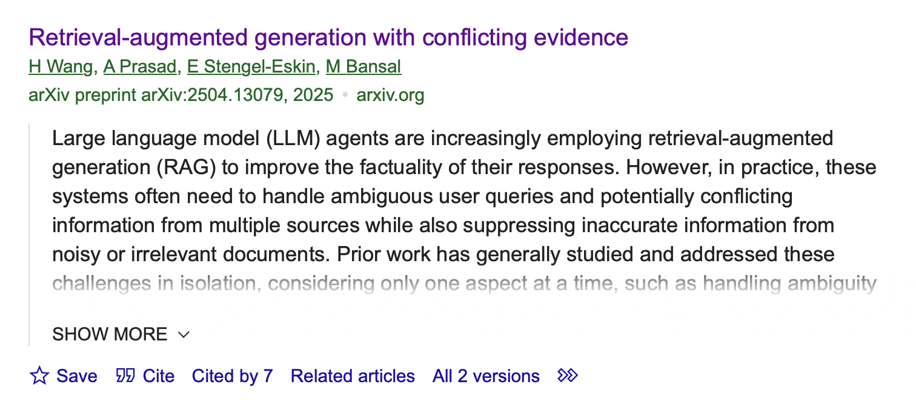
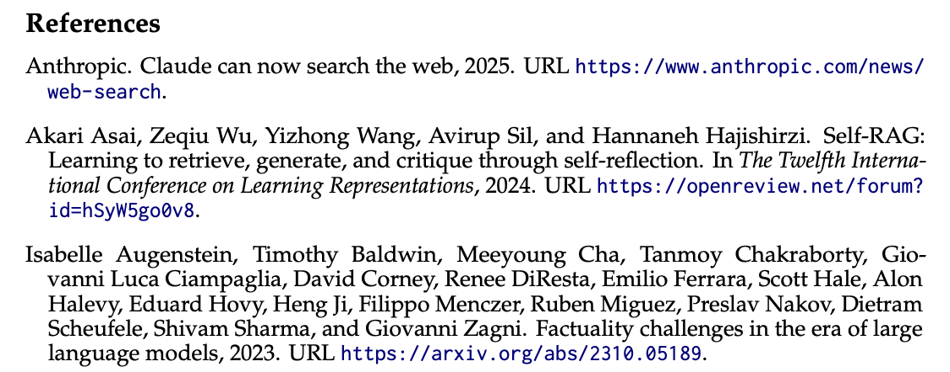
How to find papers
When reading curiously, you should be able to find related papers
Backward references and forward references
Google scholar is your friend
Generally speaking: LLMs are not your friend here (low recall, hallucinations)
Would not recommend unless you know what you are looking for (i.e. you can verify)

Slide 19
Presentation tips
Limit the amount of text on a slide
Generally, slides are visual tools (this is a bad slide)
A good rule of thumb: 1 minute per slide
Plan in pauses for questions
Some slides may be more/less (e.g. a slide with many results might need more time)
Practice your presentation to get timing right
Structure your slides (no paragraphs)
Incorporate and explain figures (draw simple figures if needed)
Incremental reveals!

Slide 20
Presentation tips
Some days have many papers
Decide what kind of paper each paper is
For example:
If it’s an older more foundational paper, focus more on the motivation/influence on other papers as opposed to the results (which might be less impressive now)
Read your papers together to try to pull out important common themes, then go back and highlight those ideas
For a lot of days, I have chosen papers with this in mind; some of the older papers introduce ideas/tasks/themes that are important for newer papers

Slide 21
Discussion time!
Let’s hear from you
No wrong answers

Slide 22
Who are you?
Who here is a:
CS graduate student
Linguistics graduate student
Neither

Slide 23
Who are you?
Who here has:
Taken an NLP course before
Taken an AI or RL course before
Done a project with LLMs
Used LLMs in their daily lives
Used LLM agents in their daily lives

Slide 24
What is an agent?
What are key features of an agent?
How is an agent different from a model?

Slide 25
Communication
What are some examples of communication?
What are the advantages/disadvantages of language communication?

Slide 26
Grounding
What does it mean for something to be grounded?

Slide 27
Multi-Agent
What does it mean for a system to be “multi-agent”?

Slide 28
Your goals
What do you want to get from this course?

Slide 29
Logistics
Assignments: Canvas
Everything else: Course website
By next class:
Fill out the presentation interest form
Note: the first presentation is 1 week from today, and will be graded accordingly.
Class after that
I have gotten 2,000 GPU hours on TACC, but you will need a TACC account. If you don’t have one already, you should make one
Other GPU resources (free for students):
Google Colab, research TPU credits
AWS and Azure both give a number of free credits when you join

Slide 30
Questions?

